Slide 1
Measuring Gypsum Boards Soaking boards to an even moisture distribution, drying, acclimating and measuring
Preliminary report
11.10.2016
Updated 9.5.2017

Slide 2
Testing
Board preparation with waxed edges
Oven test to determine weight at 0% with wax
Soaking to at least 4.6%
Acclimating; 2 methods in container or wrapped
Measuring
Drying
Acclimating
Measuring, Drying, Acclimating,…. (Steps 4-7)
Oven test to compare with oven test (Step 2)

Slide 3
Report Forms
Forms to report test results are available in excel format under file :
File 1: A-Template Worksheet for Gypsum Testing
Brd 1-Brd 6: Form 1: 1 sheet for each board, weights, acclimation, measurements
Oven Tests: Form 2: 1 sheet for oven testing performed before and after testing
Step Calculation: Form 3: 1 sheet for weight calculation soaking and acclimating
Drying: Form 4: 2 sheets to record drying for all acclimation step
Measuring Graph: 1 sheet for each board, graph for pin placement when measuring
File 2: A-Template to Enter Data by Hand
Data template complete: Enter information from Form 1. % MC oven, % MC meter, EMC %
Graph using information entered in data template

Slide 4
Select 7 boards of the same type and same manufacturer. Print out Forms to record test results.
Prepare boards, weigh, coat with wax and perform initial oven test.
Soak in gypsum water bath until target weight at 4.6% has been reached.
Note weight before placing all 6 gypsum boards into individual bags to acclimate. Choose with or without relative humidity probe. Leave at least 2 days to acclimate and measure weight again.
Wrap boards before measuring moisture content as described. Wrapping boards during measurements is essential to minimize weight loss, while boards are measured.
Take measurements as described. Boards should be wrapped in plastic, template attached and placed in plastic bag while up to 10 measurements are taken.
Drying should follow on the same day. First, dry the boards to the target acclimation weight by using ambient air. If the boards will not dry in ambient air less than 45% during a few hours, use the oven starting with 90F and then increase slowly to no more than 113F.
After drying out, the boards should be placed in the bag for at least 2 days to acclimate. Repeat steps 4-7 until Series A-I are finished, or until the resistance in the dried-out gypsum boards is so high, that the meter cannot read any more.
With this time table, testing six boards from one type from one manufacturer takes 2-3 weeks. Vacation, holidays, week ends should be timed and only take place, while the boards are placed in the bags for acclimation.
Enter all information into the File : “A-Template to enter Data for Graph”

Slide 5
General information: Cut boards rectangular, not from the edge of the panel, size 13.5cm by 16cm. Prepare 1 additional board for time test of soaking, especially important for non water resistant boards. Handling boards: - When moving boards, try to hold by edges with your hand and not the front or the back - Place boards on spacers, while resting - Place board in freezer bag and wrap in plastic if not involved in testing (overnight, lunch brake)

Slide 6
Board Identification: Give a number to each board, mark one corner on each board with “x”. Start with Form 1: A-Template Worksheet for Gypsum Testing. Print out a sheet for each board. Enter the Board number in field “B,1.04” Weigh each board and enter start weight in field “E,1.02, enter start date in field “G,1.02. Board preparation before oven testing and before applying wax. Clean edges are required before wax, cut excess cardboard with scissors. See ZW4, QN2 is clean.

Slide 7
Panel preparation: Before waxing the edges, cut excess paper off, if necessary.

Slide 8
Heating up wax for application to edges. -Melt in hot water bath in cut-off plastic bottle. Cool water bath with cold water to a temperature, when the applied wax will not turn the edges dark.

Slide 9
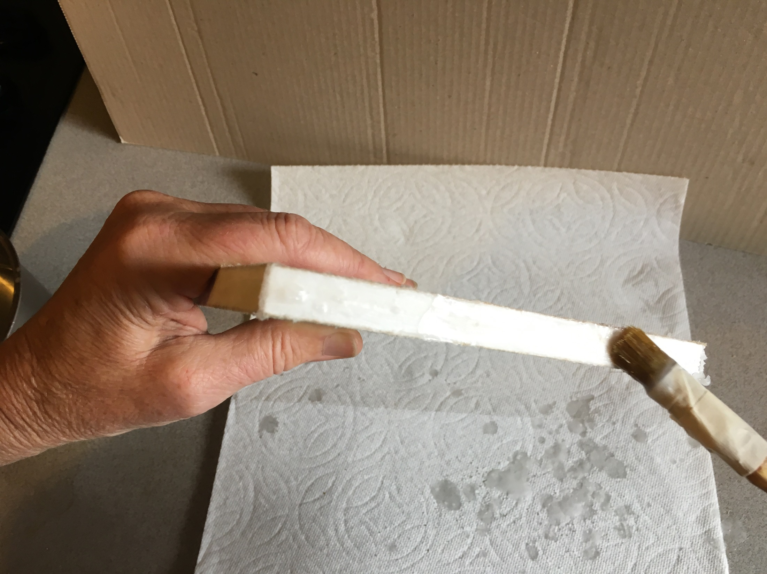
Apply wax to edges with a brush, cover all 4 sides. Avoid covering the front and back.

Slide 10
Cleaning access wax of the front and the back: -Use an X-acto knife and scrape front and back side clean of wax. Hold at approximately 15degree angle towards the board. Board is ready for Oventest. Board preparation is finished. Note weight in Form 1 with wax in field ”C,1.05”

Slide 11
Determining dry weight: Panels are set horizontal with spacers to prohibit any damage to the waxed edges. While in the oven, the wax is soft. Store to cool down, without touching the edge. Once cooled, the edges are good to touch.

Slide 12
Oven test is to be performed at 113F. The oven test is finished, when 3 consecutive weighings at least 1 hour apart, show no difference. All weights for oven drying should be entered in File 1, Form 2. Board number (B, 2.09…) and weights (C, 2.09….). Final dry weights should be written in (N,2.09…). The thus established dry weights are used to determine the target weights for soaking and the target weights for the different acclimation steps. Enter dry weights in File 1, Form 3 for each board at “C, 3.09…”. The soaking and acclimation weights are calculated for 4.6%, 2.7%, 1.9%, 1.4% -0.4g, -0.4g, -0.3g, -0.3g. Enter values in respective forms (File 1, Form 1, Brd 1… , (E,1.05) thru (M,1.05)).

Slide 13
Soak to target soaking weight in several steps with inbetween drying. Establish soaking times by testing the extra board with waxed edges. Times for submerging in water can vary betweena few seconds and several hours. Try to soak the boards to target soaking weight in at least 4 steps, more if feasible. Between each step the boards are “dried off”, see next slide. Soaking: To prohibit boards from floating on the surface of the water bath, a piece of wood with 3 or 4 non-corroding nails can be use to push the gypsum boards under the water surface. Flip gypsum boards over for each soaking interval. (Up side and down side are changed for each soaking interval).

Slide 14
Soaking: Several cycles were done to soak the boards. Leave a predetermined time to soak in several steps to 4.6%

Slide 15
Drying-off between soaking intervals: Grab edges to take out of water. Shake surface water off and dry waxed edges with paper towel. To eliminate human influence of asymmetric padding, I used layers: Lay on a flat waterproof surface for 60 seconds, as described below: First layer: 3 sheets paper towel dry. Second layer: soaked board. Third layer: 3 sheets paper towel dry. Fourth layer: flat plate (absolutely flat tile larger than board. Fifth layer: book weight 6pds. Leave paper towel, board and book sitting for 60 seconds, then record weight. Determine, if more soaking is needed or if target soaking weight has been reached.

Slide 16
Weighing sample: Use spacers on scale to eliminate putting pressure on the board. After weighing, grab board by edges and place into solution again with push-down contraption. Repeat, record weight and soaking times. Once target weight has been reached, place in Quart Ziploc freezer bags with spacers (next slides) for acclimation. Record weights in File 1, Form 1 for each board.

Slide 17
To acclimate boards, allow at least 2 days between each measurement series. The actual weight of each board before placing in acclimation “bag” should be noted on File1, Form 1 for each board (column 1.17) Suggestion for acclimation “bag”: I found the best “bag” for acclimation to be a Quart Freezer Ziploc bag. I added at least 5 spacers per side per bag. Then, I double bagged with a Ziploc “Zip’n Steam” bag. If RH probe is used, eliminate one of the center spacers. Make a slit in bag and insert RH probe with cable. Close bag with masking tape. The RH probe should not be used, for the first (second) acclimation at about 4.6% (2.6%), because at that time the relative humidity in the bag is at 99.9%. After the acclimation to 2.6% (1.9%), the relative humidity in the bag can be measured. For all consecutive acclimation steps the RH probes should be used.

Slide 18
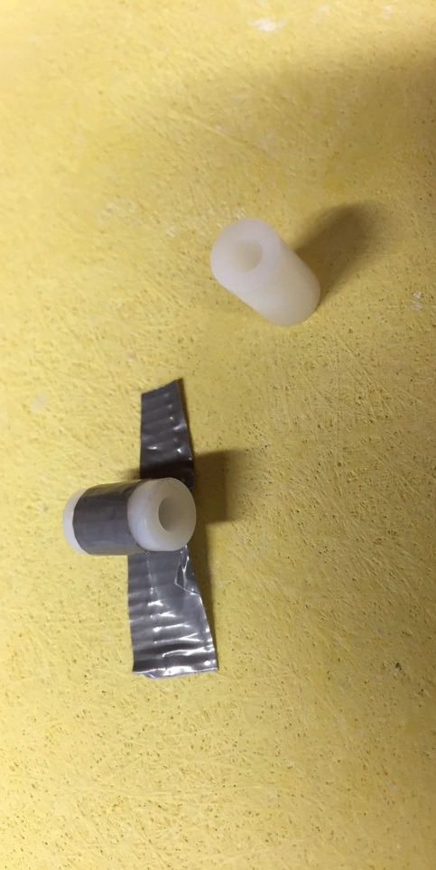
To find position of spacers, place the board in the center of the bag and close the bag. Mark position of spacer as indicated in Photo 1. Use round small cylinders Photo 3 found in hardware stores in the spacer section about 1 cm long and dia. about 7mm. Use small strip of duct tape to attach the spacers to the marked positions. Photo 2. Double bag to reduce weight loss during acclimation. As a second bag I used the Ziploc Zip’n Steam bags, which are slightly larger than the freezer bags.

Slide 19
After each completed acclimation step, the actual weights are entered into File 1, Form 1 (column 1.22). For higher humidity levels up to 0.5g were lost during acclimation in bags. After weighing, the boards need to be wrapped to eliminate weight loss, while taking moisture readings. Wrap the board completely into GLAD Press’n Seal plastic for measuring. Cover front and back surface of entire board, with the sticky side on the outside (not facing the board). Leave surface and bottom of board free of extra plastic wrap, fold or roll along edge. See photo.

Slide 20
Print Measuring Graph, one template for each board. Template allows placement for 9 different acclimation steps with up to 10 measurements per step. After wrapping board as indicated in previous slide, place template on sticky outside matching X on template with X on board. Place wrapped gypsum board with template in a freezer bag. Take measurements. Insert pins slowly by hammering with very little force to enter the pins into the center of the board. I marked the green teflon-coating on the pins with a waterproof pen to indicate when pins are halfway inserted, see also next slide. Start with A1 through A10 for A series (4.6%). When placing template for next measuring series, match pin holes of previous measurements, to guarantee even distances between pin holes. Enter measurements in Form 1, columns 1.28 through 1.37, starting with (D, 1.28) for Series A.

Slide 21
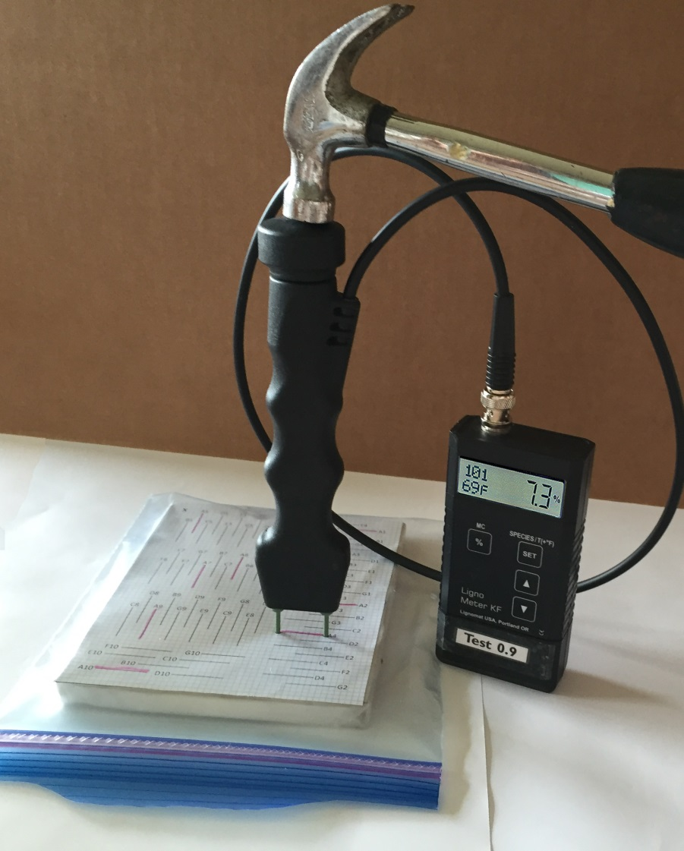
Set the meter to setting number 101 and the temperature to ambient temperature. I used a hammer to insert pins slowly, carefully for measurement. -Standard boards covered with paper: wet paper measures higher than the core. -Glass Mat panel board give lower surface measurements than the core. After each measurement, clean tip of pins with a wet cloth and a dry cloth.
 | Measuring: Meter Setting 101 , I used a hammer to insert the pins slowly and carefully. With the hammer you can control the depth of penetration better. I noted only one reading, either max or min value, ignoring the higher or lower surface measurements. Do not hurry and wait it least 2 seconds to get a stable, accurate moisture value for each measurement. I took 10 measurements per acclimation. Values from meter are entered into File 1, Form1.

Slide 22
Drying to next step
Drying to the next step can be either done by air drying or oven drying. The first few times for Series A-B and B-C and C-D air drying is possible. Once the air drying takes too long, use the oven at a lower temperature than 113F with intermittent weight measurements to avoid over-drying Use form in worksheet under drying, print a form for each board.
After E-Series has been measured, for the next drying steps subtract 0.4gram from the weight after measuring the previous step and dry to that weight.
Do not use the calculated steps because weights change too much during acclimation.

Slide 23
For smooth testing:
Oven testing: Is it permissible to leave boards overnight in the drying chamber. If no more weight loss over night could be recorded, dry weight has been reached.
One oven tests is performed before soaking the boards. Another oven test is performed after the test series is completed and all measurements have been obtained. The results showed that values before and after testing may vary.
 | Difference in initial and final Oven Test (before and after Measurements)
 |  | Board | Board | Board | Board
 | acclimate | OW | PR | GM | AW
 | in box | +0.4 | +0.5 | 0
 | in box | +0.5 | +0.7 | +0.1
 | plastic bag | +0.1 | +1.0 | -0.2 | -0.6
 | plastic bag | +0.1 | +1.0 | 0 | -0.6
 | plastic bag with RH | +0.6 | +0.8 | -0.2 | -0.8
 | Average weight g | 180 | 180 | 220 | 230

Slide 24
Calculating the true, actual moisture content in percent for each measuring series based on oven dry test.
To calculate the true, actual moisture content of the gypsum boards for each measuring series, the actual weight A is needed and the oven weight O is needed.
Formula ((A-O):O)x100 moisture content in %.
After each measuring series is completed, the weights are recorded in File 1, Form 1, row 1.22. The values are used for “A”.
Since the oven weights vary before and after testing, I used the initial oven test weight for calculating the highest moisture content and the final oven test weight for calculating the lowest moisture content (File 1, Form 2) and entered those values in File 1, Form 1, (D, 1.23) and (I,1.23). Next, I distributed the difference between initial and final oven weights evenly between highest and lowest moisture values File 1, Form 1, row 1.23. Values are used for “O”.
The moisture content is automatically calculated using the formula above and is found in File 1, Form 1, row 1.41.

Slide 25
Select 7 boards of the same type and same manufacturer.| Print out Forms to record test results.
Prepare boards, weigh, coat with wax and perform oven test.
Soak in gypsum water bath until target weight at 4.6% has been reached.
Note weight before placing all 6 gypsum boards into individual bags to acclimate. Choose with or without relative humidity probe. Leave at least 2 days to acclimate and measure weight again.
Wrap boards before measuring as described. By wrapping boards during measurements, there is hardly any weight loss, while the boards are being measured.
Take measurements as described. Boards should be wrapped in plastic, with template and placed in plastic bag while up to 10 measurements are taken.
Drying should follow measurements on the same day. First, dry the boards to the target acclimation weight by using ambient air. If the boards will not dry in ambient air during a few hours, use the oven starting with 90F and then increase slowly to no more than 113F.
After drying out, the boards should be placed in the bag for at least 2 days to acclimate. Repeat steps 4-7 until Series A-I are finished, or until the resistance in the dried-out gypsum boards is so high, that the meter cannot read any more.
With this time table, testing six boards from one type from one manufacturer takes 2-3 weeks. Vacation, holidays, week ends should be timed and only take place, while the boards are placed in the bags for acclimation.
Enter all information into the file: A-Template Worksheet for Gypsum Testing
Finish the math. Enter the information at the bottom of file 1 into the file: A-Template to Enter Data by Hand.

